Slide 1
Fraud Risk Intelligence
BY Midhun Manohar

Slide 2
Executive Summary
The objective is to minimize financial losses for PaySphere Digital Payments Pvt. Ltd. by detecting anomalous transactions prior to settlement.
Traditional rule-based system struggle to keep up with evolving fraud tactics, leading to slow manual reviews and high false-positive rates.
Approach: Developed a robust machine learning pipeline that identifies complex, non-linear fraud patterns within transaction data.
Deliverable: An interactive, real-time Fraud Risk Intelligence dashboard built with Streamlit, empowering risk analysts to make faster, data-backed decisions.
Result: Model has to achieved better accuracy in fraud detection, improving the overall performance compared to baseline rule-based systems and enabling more reliable identification of fraudulent transactions.

Slide 3
Business Impact
Blocking a legitimate user doesn't just lose us that single transaction. It creates a terrible user experience that damages brand trust, drives high-value customers straight to competitors, and destroys long-term Customer Lifetime Value (CLV).
The Target—Mastering the Precision-Recall Balance: Pure accuracy is a vanity metric in fraud detection.
The main goal is maximizing Recall (catching as many bad actors as possible) while maintaining sky-high Precision (ensuring that when we flag someone, we are confident they are actually a threat, minimizing friction for the good guys).

Slide 4

Data Ingestion
We started by securely extracting raw historical transaction logs.
The dataset (transaction_fraud.csv) includes January–March transaction records, consisting of 50,000 observations and 25 features capturing customer, device, and transaction-level attributes.
This formed the foundational dataset needed to teach the model what "normal" versus "fraudulent" behavior looks like.

Slide 5
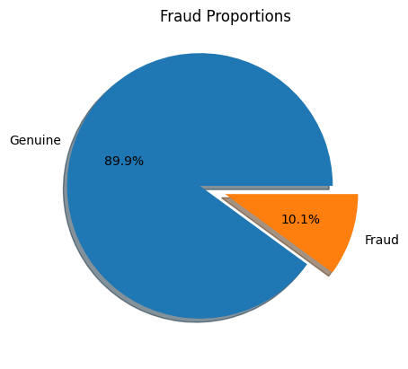
Data Exploration
Exploratory analysis revealed that the dataset is moderate imbalanced, with significantly fewer fraud cases compared to legitimate transactions.
The dataset contains approximately 10.1% fraudulent and 90% genuine transactions, indicating a moderate class imbalance.

Slide 6


Data Preprocessing
Comprehensive data quality checks revealed no missing values or duplicate records. Further validation confirmed consistency and integrity across both numerical and categorical variables, with no anomalous or invalid entries detected.
Preventing Data Leakage: The data was divided into training and testing sets before performing any resampling or balancing. This prevents data leakage and ensures the model is evaluated fairly on new, unseen transactions.

Slide 7
Feature Engineering
Feature engineering enhances raw transaction data by creating meaningful patterns that improve fraud detection, especially since fraudulent transactions are rare and closely resemble legitimate ones.
01
03
05
07
09
11
cust_txn_count
cust_fraud_rate
amt_deviation
device_count
merchant_fraud_rate
combined_risk
02
04
06
08
10
cust_fraud_count
cust_avg_amt
amt_ratio
new_device_flag
otp_risk

Slide 8
Feature Selection
Feature selection is a critical step in the machine learning development process. It involves identifying and selecting the most relevant features that significantly influence the target variable. Proper feature selection helps reduce multicollinearity, removes redundant or irrelevant variables, improves model performance, and enhances interpretability. It also reduces computational complexity and helps prevent overfitting.
Instead of relying on a single method such as a correlation heatmap, we adopted a more robust and comprehensive approach by applying multiple feature selection techniques. This helps ensure that the selected features are consistently important across different modeling perspectives.
Random Forest Feature Importance
6
Logistic Regression Coefficients
1
Feature Selection
Techniques
Gradient Boosting Feature Importance
2
5
Recursive Feature Elimination (RFE)
Permutation Importance
4
L1 Regularization (Lasso)
3

Slide 9

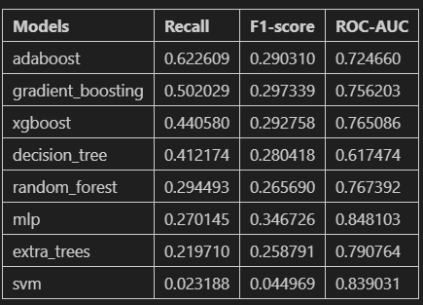
Model Selection
We applied multiple models—first simple ones to understand the data, and then stronger ensemble models to improve performance.
Evaluation Metrics: Because of the extreme class imbalance, traditional "Accuracy" is a trap. We evaluated our models strictly on the Recall, F1-Score and ROU-AUC (Precision-Recall Area Under the Curve).
Although Ada-Boost had the highest recall, Gradient Boosting offered a better overall balance and was chosen as the final model.

Slide 10

Hyperparameter Optimization
We didn't just use the out-of-the-box settings. We aggressively tuned the model's parameters (using StratifiedKFold and Grid Search) to maximize its ability to generalize to unseen fraud tactics without overfitting the training data.
We applied advanced sampling techniques (like SMOTE or class weighting) to force the algorithm to learn the complex patterns of the minority class.
After performing hyperparameter tuning on the Gradient Boosting model, the optimal set of parameters obtained were a learning rate of 0.01, maximum tree depth of 3, minimum samples required to split a node of 2, minimum samples required at a leaf node of 1, and 200 estimators.
To ensure a structured and reproducible workflow, the entire modeling process was implemented using a machine learning pipeline. The pipeline integrates multiple stages of the model development process into a single workflow, including data preprocessing, class imbalance handling, and model training.
Best Params
'classifier__learning_rate': 0.01, 'classifier__max_depth': 3, 'classifier__min_samples_leaf': 1, 'classifier__min_samples_split': 2, 'classifier__n_estimators': 200

Slide 11
Confusion Matrix
To better understand the model’s performance, a confusion matrix was constructed. The confusion matrix helps break down the model’s predictions into four categories: True Positives, True Negatives, False Positives, and False Negatives. This provides a more detailed view of how the model is performing beyond overall accuracy.
Case 1: Missing Fraud
Customer loses money
Bank Refunds
Reputation Damage
Case 2: False Alaram
Customer Verification
OTP Verify
Temporary Block
Predict Spam
Predict Not Spam
True Positive | False Negative Type II Error
False Positive Type I Error | True Negative
Actual Spam
Actual Not Spam
The worst-case error is Type II (False Negative), where a fraudulent transaction is classified as legitimate. This can cause financial loss to both the customer and the bank. Therefore, the focus is on improving recall to detect as many fraud cases as possible.
Type II Error
Type I Error

Slide 12
Ordinal vs One-Hot Encoding
Ordinal Encoding
One-Hot Encoding
Recall: 0.738
F1-score: 0.401
ROC-AUC: 0.8526
False Negatives: 452
False Positives: 3347
The model achieved higher recall with ordinal encoding, meaning it successfully identified a larger proportion of actual positive cases. It also produced a slightly higher ROC-AUC score, indicating strong class separation capability.
Recall: 0.670
F1-score: 0.406
ROC-AUC: 0.8496
False Negatives: 569
False Positives: 2811
One-hot encoding slightly improved the F1-score and reduced false positives. However, it resulted in lower recall and a higher number of false negatives compared to ordinal encoding.
Final Decision:
Considering the higher recall, better ROC-AUC score, and lower number of false negatives, Ordinal Encoding was selected as the final encoding technique.

Slide 13
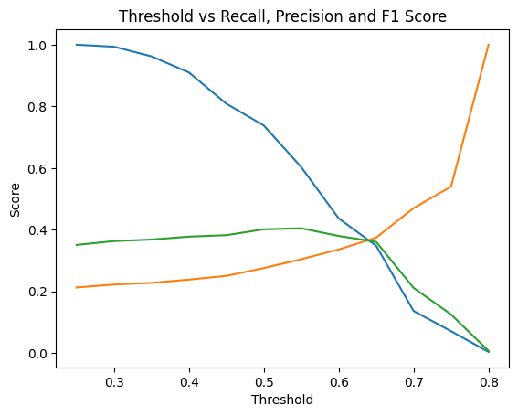
Threshold Tuning
For this project, the classification threshold was adjusted to optimize fraud detection performance instead of using the default value of 0.5.
From the graph, the best balance occurs around a threshold of approximately 0.6–0.65. At this range, the model maintains a good recall while improving precision, which results in a relatively higher F1-score.
This threshold helps the model detect more fraudulent transactions while keeping false positives at a manageable level, making it suitable for the fraud detection objective.
Based on threshold analysis, 0.5 was selected as it maximized the F1-score while maintaining a reasonable balance between precision and recall.

Slide 14

Final Model
For the final model, a Gradient Boosting classifier was used within a machine learning pipeline. The pipeline integrates data preprocessing, class imbalance handling using SMOTE, and model training into a single workflow, ensuring consistent data transformation and preventing data leakage.
Recall: 0.738
Precision: 0.276
F1-Score: 0.401
ROC–AUC: 0.853
The confusion matrix shows that the model correctly identified 1,273 fraudulent transactions (True Positives) while 452 fraud cases were missed (False Negatives). For legitimate transactions, 11,521 were correctly classified (True Negatives), while 3,347 were incorrectly flagged as fraud (False Positives).
Since the primary objective of this project is fraud detection, the model prioritizes higher recall to capture as many fraudulent transactions as possible. Although this leads to a higher number of false positives, it significantly reduces the risk of undetected fraud, which is more critical for both customers and financial institutions.

Slide 15
Recommendation
Threshold-Based Risk Strategy:
The model outputs a fraud probability between 0 and 1, so choosing the correct decision threshold is important.
Different thresholds are recommended for different risk levels:
Low Friction (0.70): Prioritizes customer experience with fewer fraud alerts.
Balanced (0.50): Provides a balance between fraud detection and customer convenience.
Maximum Security (0.30): Prioritizes fraud detection by capturing almost all suspicious transactions.
This dynamic threshold strategy allows organizations to apply different security levels depending on transaction risk.
Rules Engine for Immediate Fraud Prevention:
In addition to the machine learning model, hard security rules are recommended.
These rules instantly block obvious high-risk patterns without waiting for model predictions.
Examples include:
High IP risk score with low device trust.
Transaction amount much higher than the customer’s normal behavior.
New device with sudden location change.
Merchants with historically high fraud rates.

